Slide 1

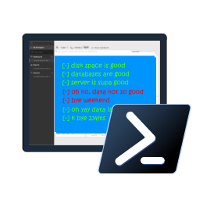

SQL Notebooks in Azure Data Studio for the DBA
Rob Sewell -@SQLDBAWithBeard

Slide 2
WHO AM !?

Slide 3
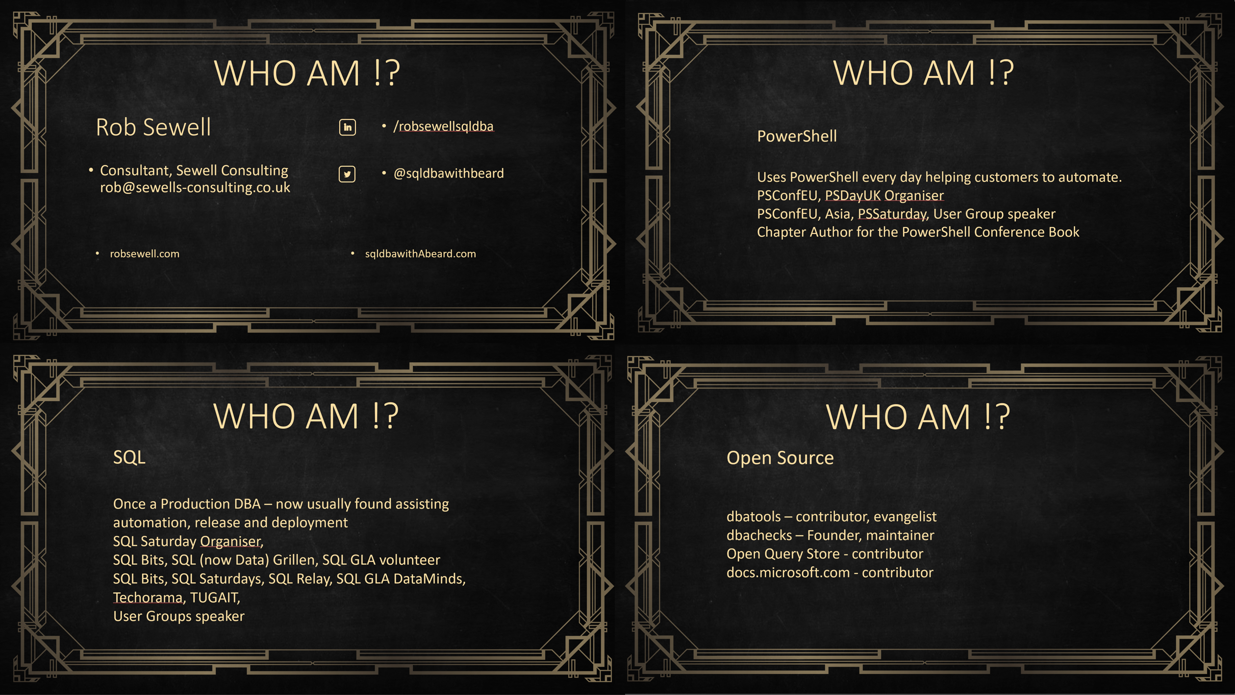


Slide 4

Here Now ! dbatools.io/book
The MEAP has opened for dbatools in a Month of Lunches
New book from Manning
Your Code for 50% off ctwdmind19

Slide 5
Slides and Code
All my Presentations
github.com/SQLDBAWithABeard/Presentations

Slide 6
What’s Azure Data Studio?

Slide 7
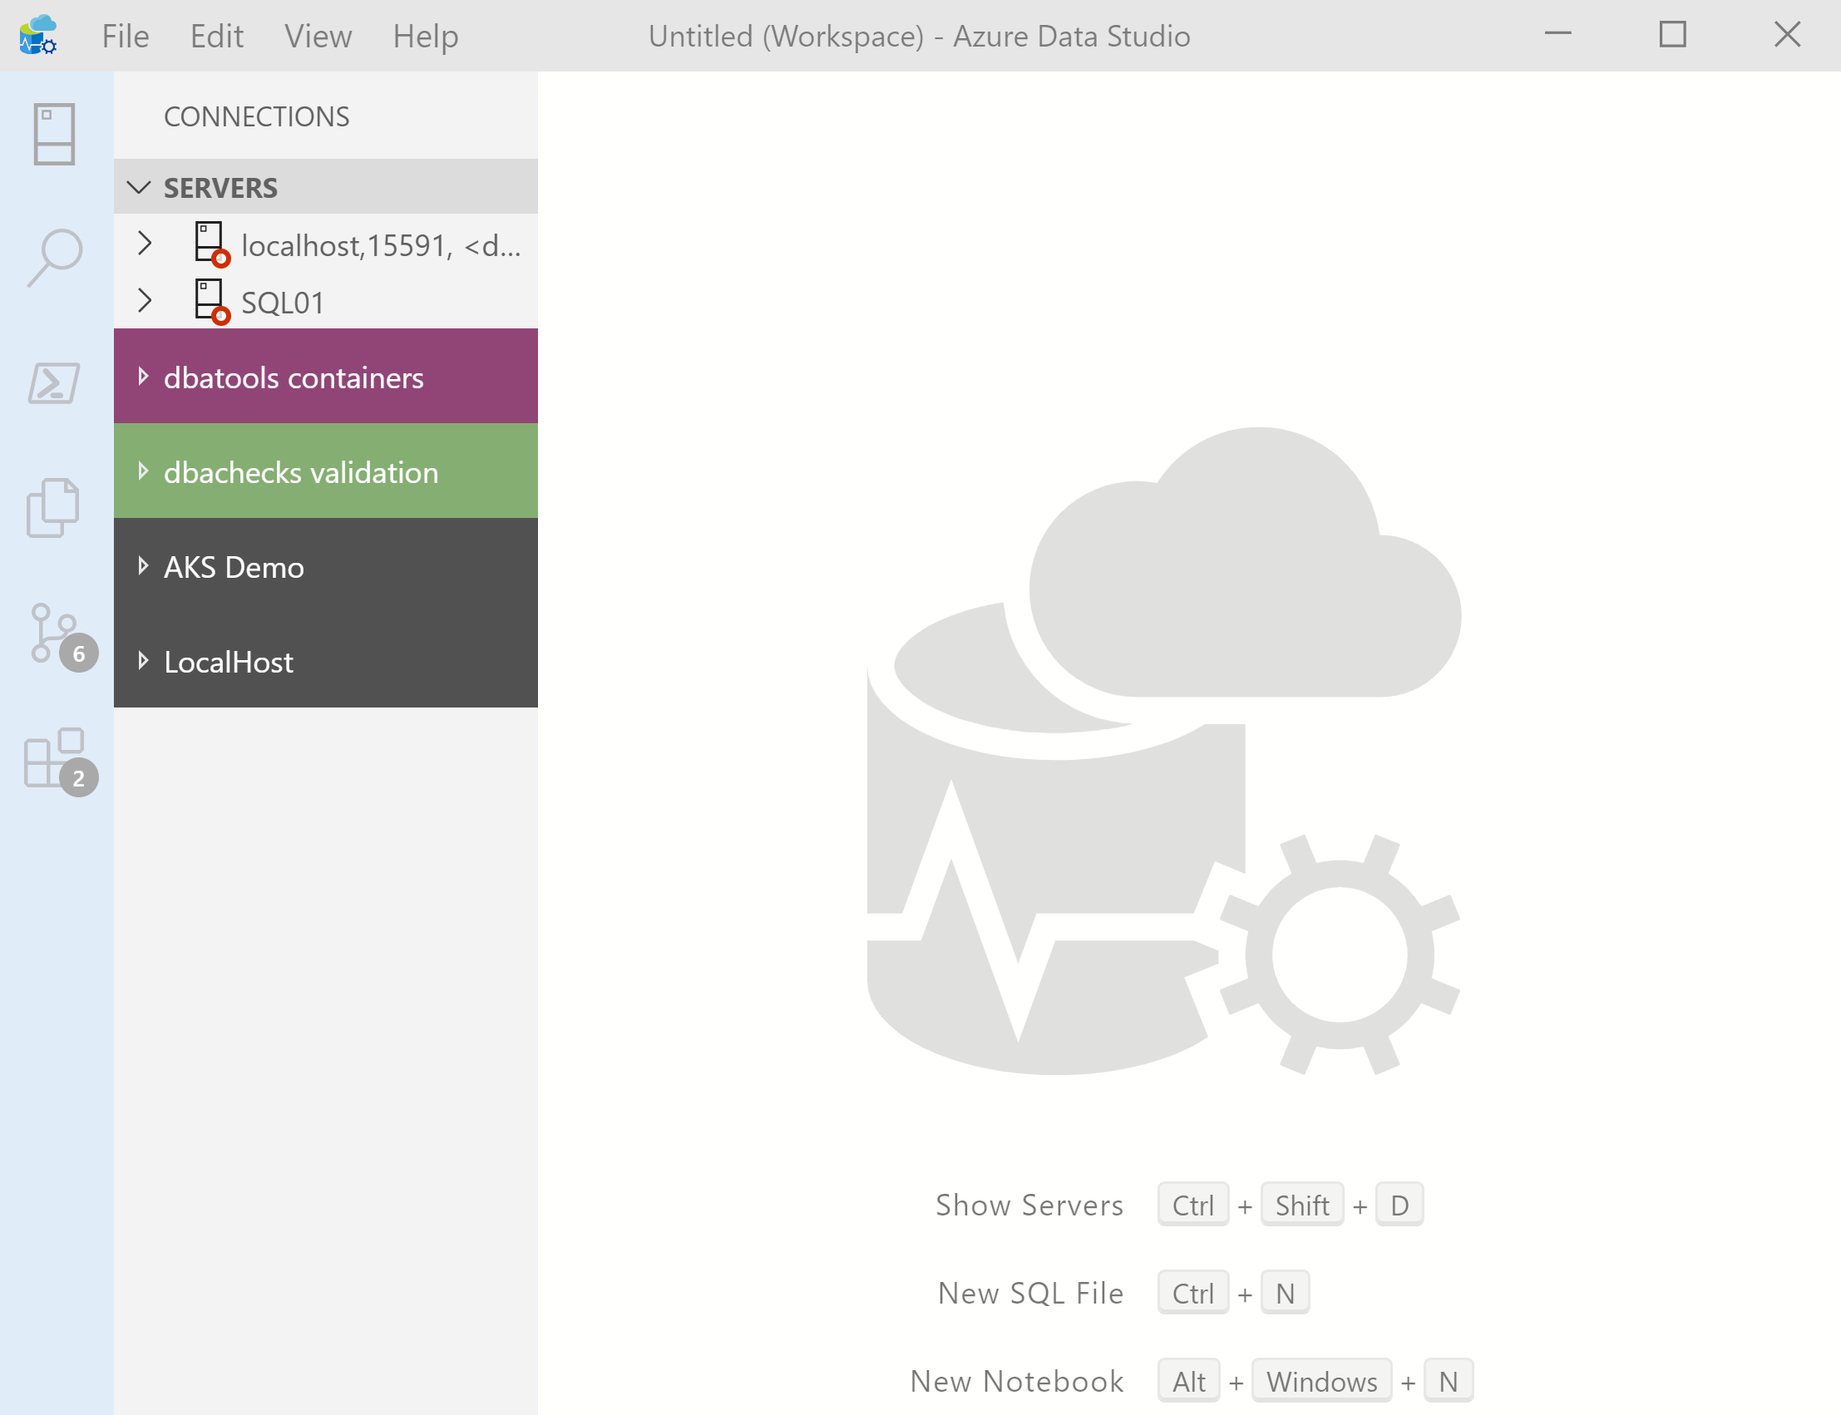
What’s Azure Data Studio ?
Cross Platform desktop environment for Data Professionals

Slide 8

So it’s only for Azure?

Slide 9
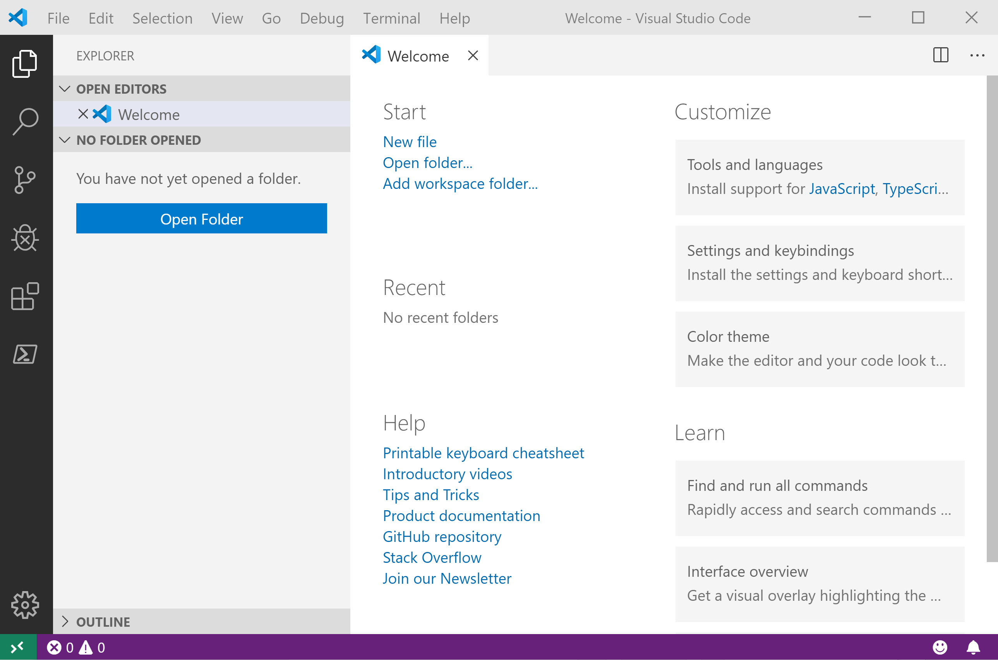
It Looks Like Visual Studio Code ?

Slide 10
It Looks Like Visual Studio Code ?

Slide 11
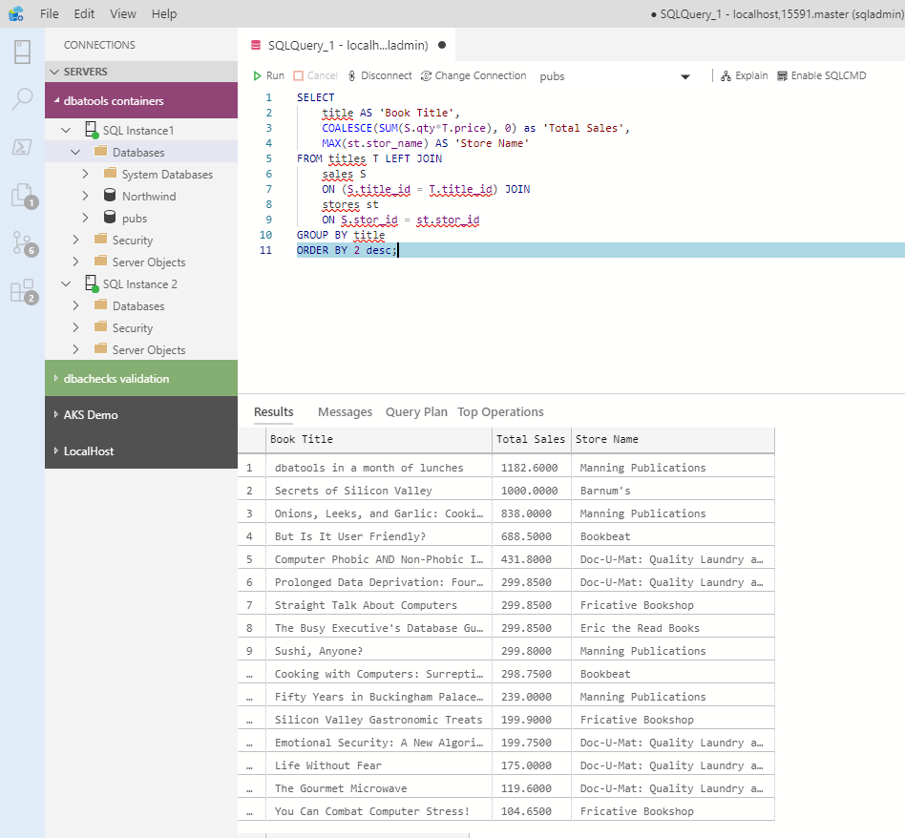
What can you do in Azure Data Studio ?
You can run T-SQL queries!

Slide 12
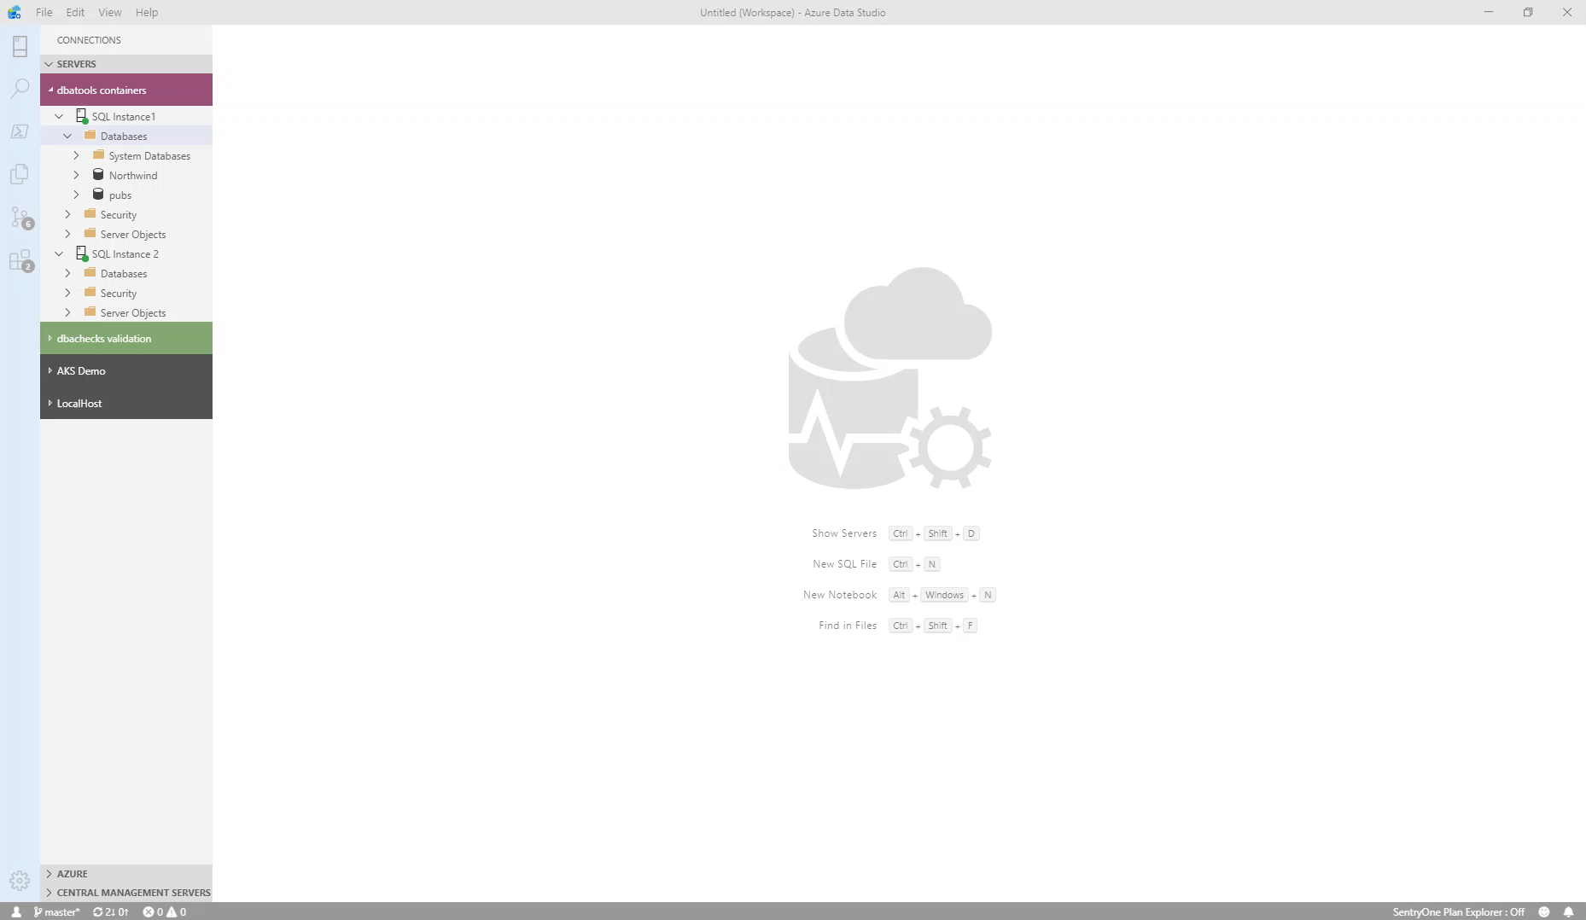
What can you do in Azure Data Studio ?
You can get execution plans

Slide 13
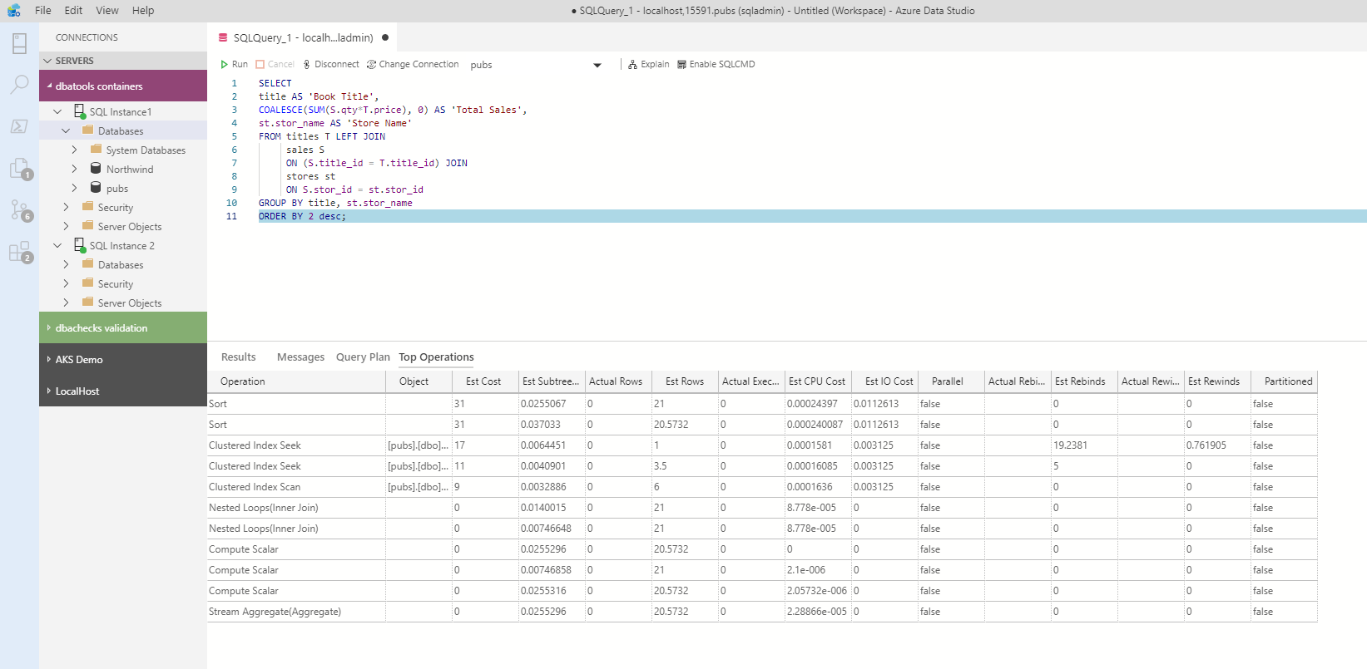
What can you do in Azure Data Studio ?
You can get the top operations

Slide 14
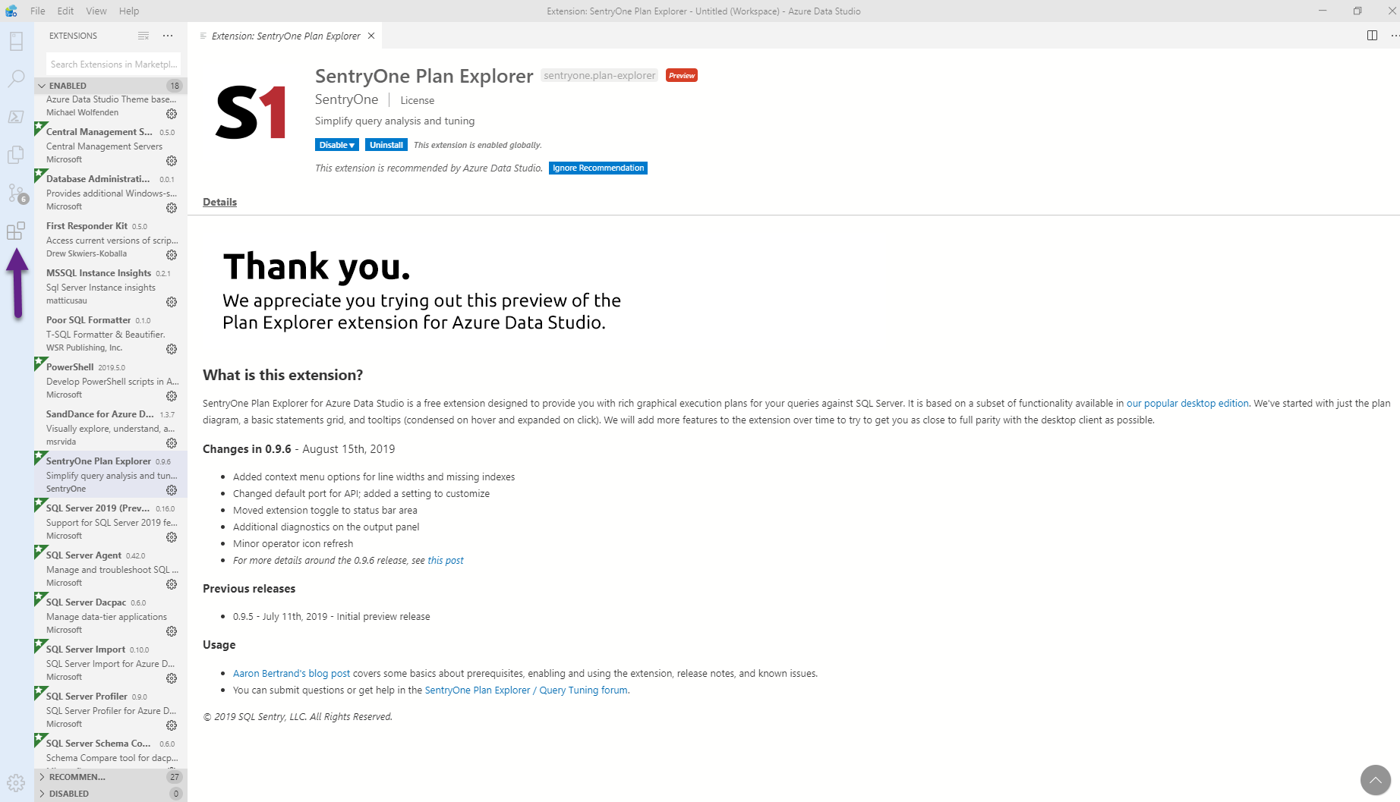
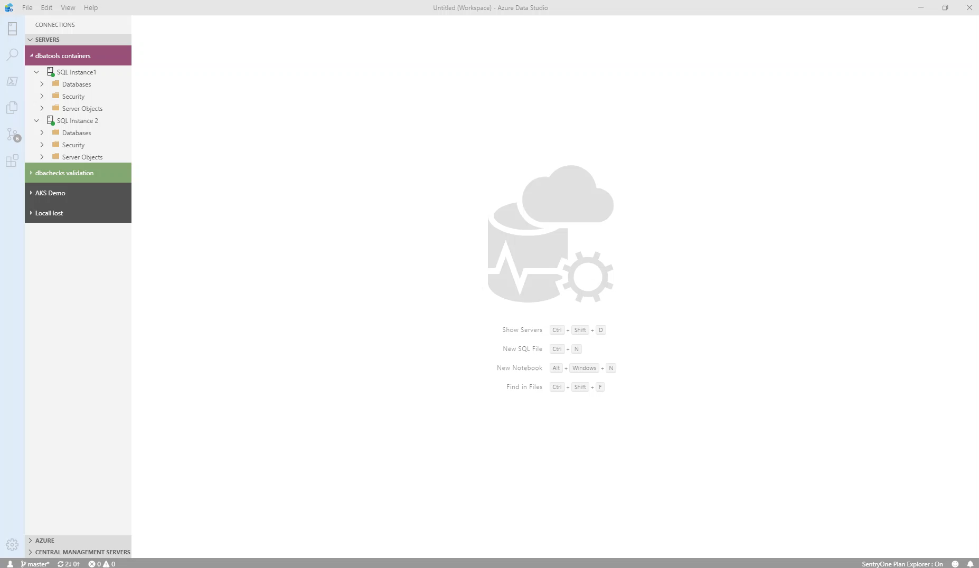
What can you do in Azure Data Studio ?
You can install extensions for more functionality

Slide 15
What can you do in Azure Data Studio ?
And get Plan Explorer

Slide 16
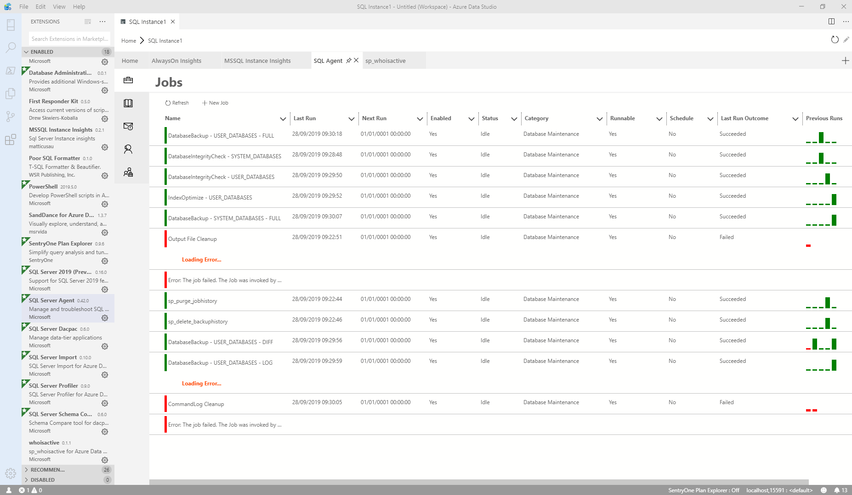
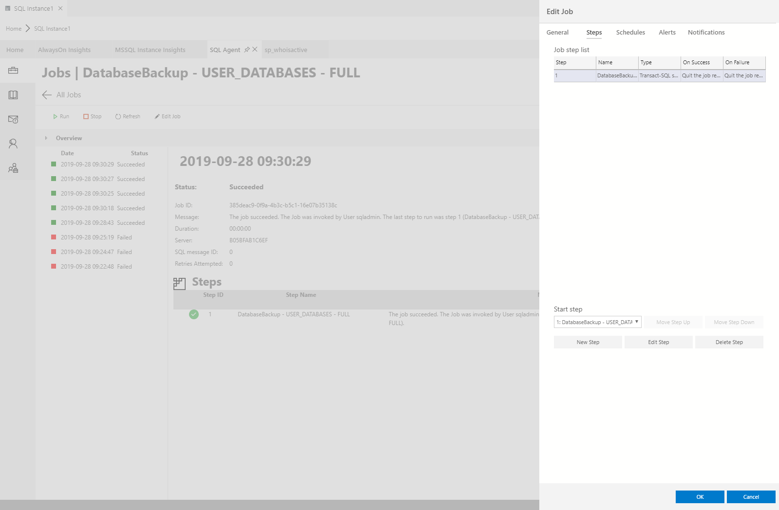
What can you do in Azure Data Studio ?
You can work with SQL Agent Jobs

Slide 17
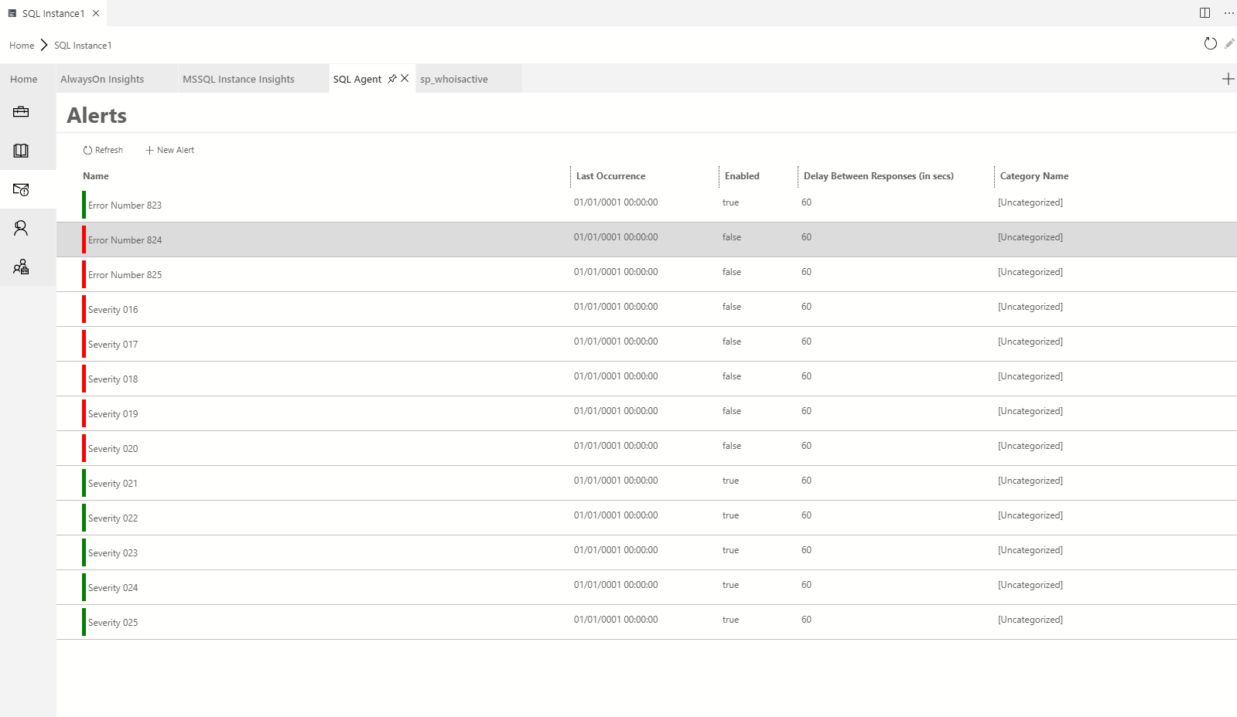
What can you do in Azure Data Studio ?
You can work with SQL Agent Jobs

Slide 18
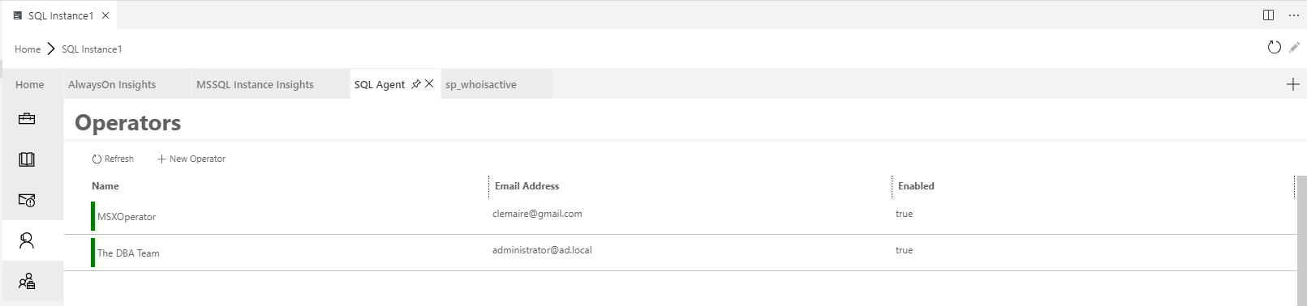
What can you do in Azure Data Studio ?
You can work with Alerts

Slide 19
What can you do in Azure Data Studio ?
You can work with Operators

Slide 20
What can you do in Azure Data Studio ?

Slide 21

What can you do in Azure Data Studio ?

Slide 22
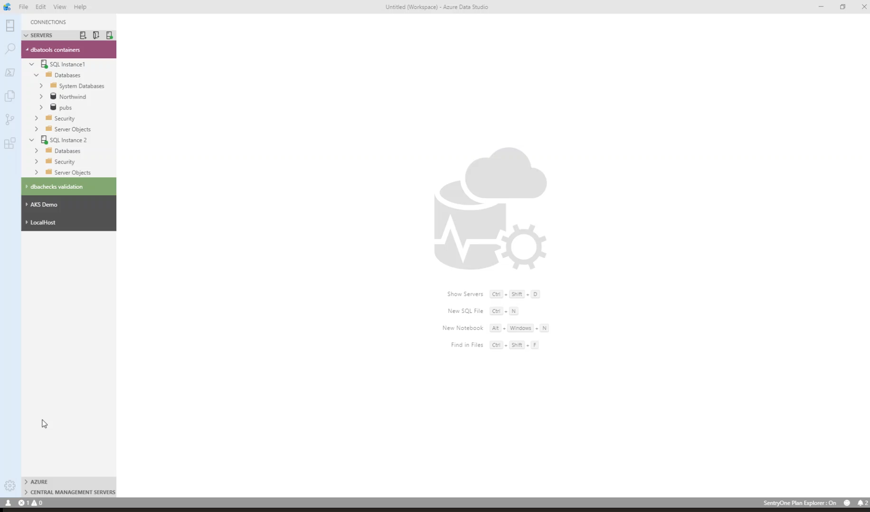
What can you do in Azure Data Studio ?
You can run PowerShell ☺

Slide 23
What’s A SQL Notebook?

Slide 24

What is a SQL Notebook?
Originally for Data Scientists

Slide 25
What is a SQL Notebook?
Document that can contain text, code, images and query results

Slide 26
I’m a DBA

Slide 27
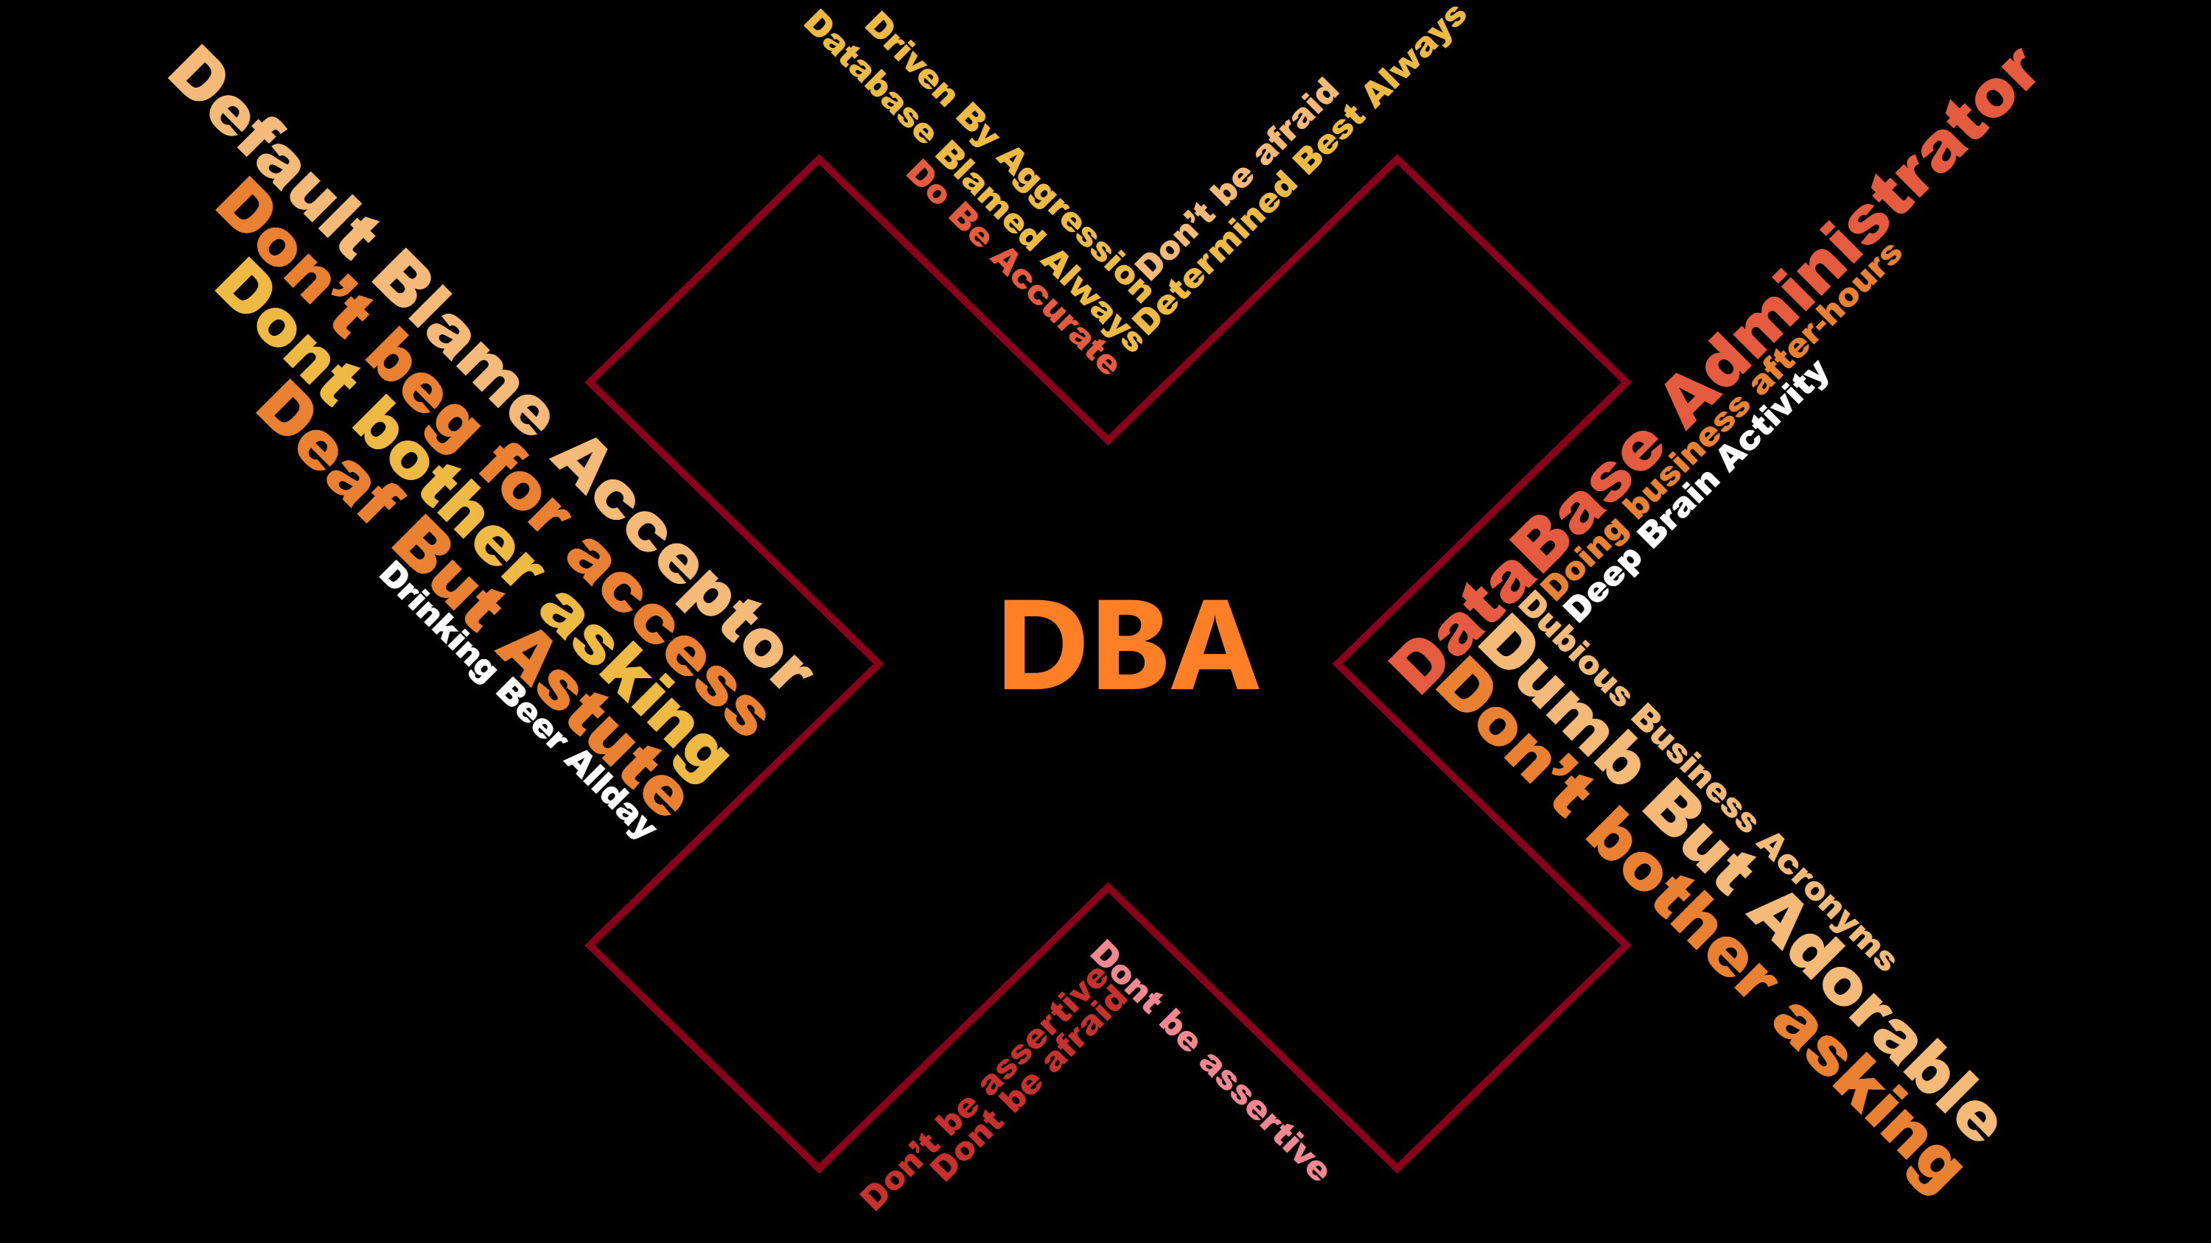

Slide 28

Let Your Mind Run Free
Photo by Alice Donovan Rouse on Unsplash

Slide 29
Some Ideas
Run Books
Training
Incident response templates – for Service Desk and for DBAs
Templates for common functions
Demoing
Share Data with a 3rd Party

